Slide 2
Water is FUN!
Notes:
Tell the pupils that water is fun, but that it is very important to stay safe near water
Ask the pupils how many of them have been near water today?
What are some fun things that you can do in water?

Slide 3
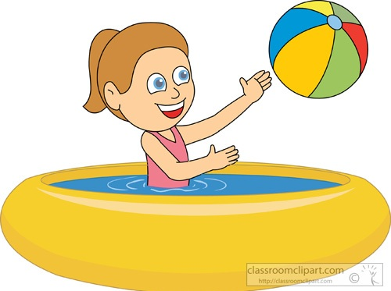
Water in and around the home
Bath
Washing machine
Paddling pool
Sink
Water butt
Fish pond
Notes:
Ask the pupils how many things they can think of that contain water at home
Some suggestions are provided on this slide, pupils may come up with lots more

Slide 4
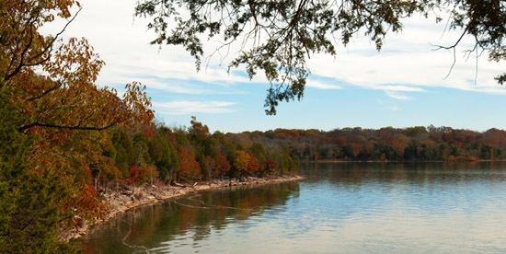
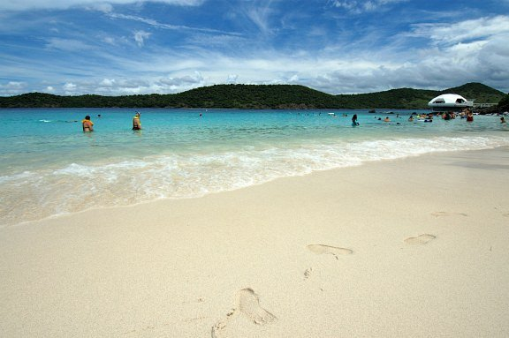
On your way to school
Rivers
Lakes
Sea
Notes:
Ask the pupils how many of them travelled past open water on their way to school and what kind of water was it?
Canal
River
Stream
Reservoir
Lake
Sea

Slide 5
How to stay SAFE
Notes:
Tell the pupils that the best way to stay safe near water is to remember the SAFE code
Give out the code or display in the classroom
Recite with the pupils, you call out the letter and let them tell you what it means
Repeat, altering the pattern in which you ask the letters

Slide 6
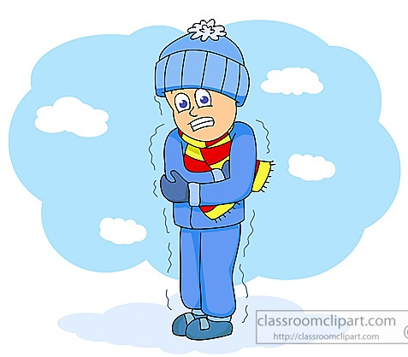
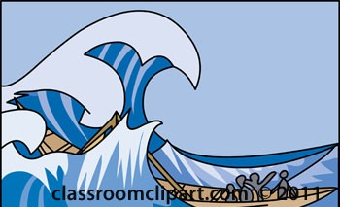
S is For?
Water can be
very cold
Large waves caused by the wind
Notes:
Spot the dangers!
Water may look safe, but it can be dangerous
Learn to spot and keep away from dangers
You may swim well in a warm indoor pool, but that does not mean that you will be able to swim in cold water
Learn about the hazards at swimming pools and open water locations
It is very cold
There may be hidden currents
It can be difficult to get out (steep slimy banks)
It can be deep
There may be hidden rubbish, e.g. shopping trolleys, broken glass
It is difficult to estimate depth
It may be polluted and may make you ill
No lifeguards
Split the pupils into groups and get a child/pair to act out a danger or hazard, getting the rest of the group to guess

Slide 7
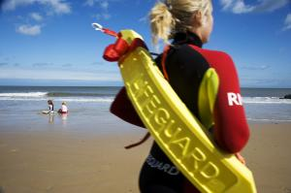
A is for?
Always listen to the Lifeguard
Notes:
Take safety advice
Read the signs
Listen to the Lifeguards
Special flags and notices may warn you of danger
Know what the signs mean and do what they tell you

Slide 8
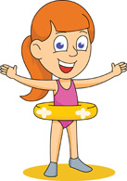
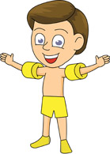
F is for?
Notes:
Always go with a friend
Children should always go with an adult, not by themselves
An adult can point out dangers or help if someone gets into trouble
If one person gets into difficulty, the other can get help
Never swim alone

Slide 9
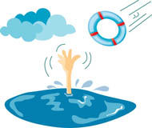
E is for?
Call 999
Is there any rescue equipment you can use?
Notes:
Learn how to help
Learn personal survival skills
Learn how to help others
You may be able to help yourself and others if you know what to do in an emergency
If you see someone in difficulty, tell someone, preferably a Lifeguard if there is one nearby
Or go to the nearest telephone, dial 999, ask for the Police at inland water sites and the Coastguard at the beach
NEVER GO INTO THE WATER TO RESCUE SOMEONE

Slide 10
Know your beach flags
On beaches patrolled by lifeguards, different flags tell you where it’s safest to swim and which areas are designated for water sports:
The area between the red and yellow flags is patrolled by lifeguards
The area between black and white chequered flags is a designated area for
water sports
The orange windsock means there are offshore winds
The red flag indicates that it is dangerous to swim or get in the water
Notes:
Red and Yellow flag - this is the safest place to swim, bodyboard or use inflatables
Black and White flag – a designated area for watersports such as surfing and kayaking. Never swim or bodyboard here
Orange windsock - never use an inflatable when you see the sock flying as the wind could push you offshore very quickly
Red flag - never go in the water when the red flag is flying

Slide 11
Activities
In pairs, quiz each other on what the SAFE code is
Produce a SAFE poster for children in the year below you
Using the slide on beach flags, work in groups to produce a flag and explain what it tells you about water safety
All images courtesy of classroomclipart.com

