Slide 1
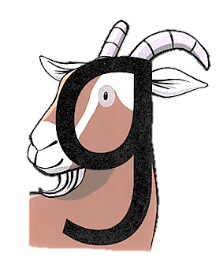
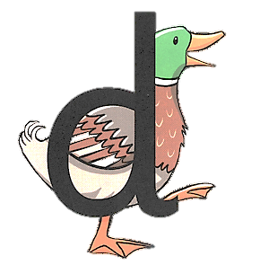
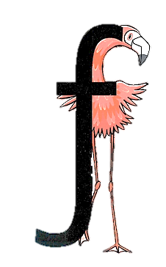

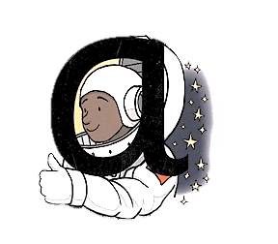
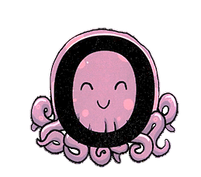
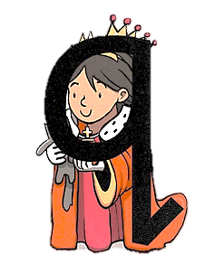

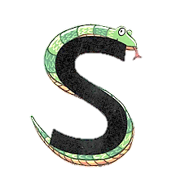

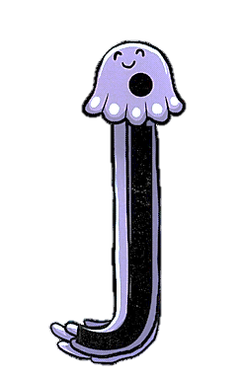


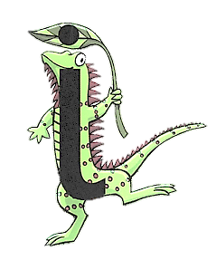
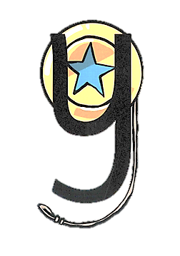
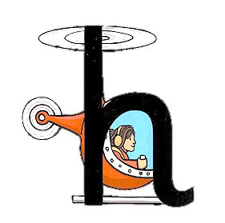

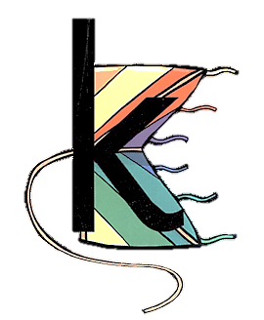
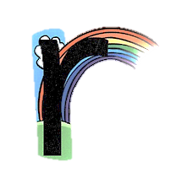
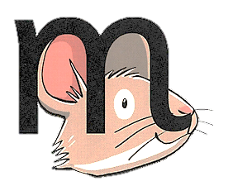

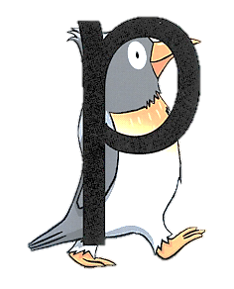


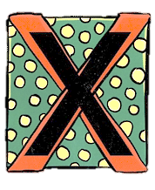


Slide 2



Curl around the cat.
Menu
The letter name is…’see’

Slide 3


Around the astronaut’s helmet,
and down into space!
Menu
The letter name is…’ay’

Slide 4


All around the octopus!
Menu
The letter name is…’oh’

Slide 5

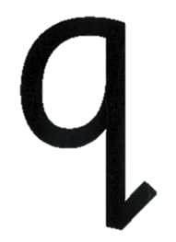
Around the queen’s face,
up to her crown,
down her robe with a flick at the end!
Menu
The letter name is…’queue’

Slide 6


Menu
Around the goat’s face,
up to his ear,
then curl under his chin.
The letter name is…’jee’

Slide 7


Around the duck’s body,
up to its head,
then down to its feet.
Menu
The letter name is…’dee’

Slide 8

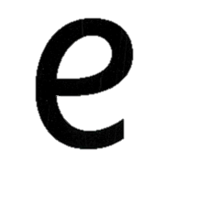
Around the elephant’s eye,
and down its trunk.
Menu
The letter name is…’ee’

Slide 9


Under the snake’s chin,
Slide down and around its tail.
Menu
The letter name is…’ess’

Slide 10


Down the flamingo’s neck,
All the way to its foot,
Then across its wings.
Menu
The letter name is…’eff’

Slide 11


All the way down the lollipop
Menu
The letter name is…’ell’

Slide 12


Down the iguana’s body, then draw a dot at the top for the leaf
Menu
The letter name is…’igh’

Slide 13


Down the jellyfish’s body, with a dot for his head.
Menu
The letter name is…’jay’

Slide 14


Down the jellyfish’s body, with a dot for his head.
Menu
The letter name is…’tee’

Slide 15


Down and around the umbrella,
stop at the top,
and down to the bottom with a flick.
Menu
The letter name is…’yoo’

Slide 16

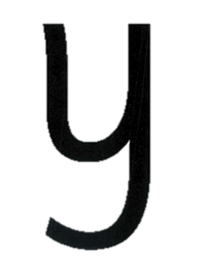
Menu
Down and around the yoyo,
then follow the string around.
The letter name is…’wie’

Slide 17


From the cloud to the ground,
up the arch and over the rainbow
Menu
The letter name is…’ar’

Slide 18


Down, up and over the mouse’s ears,
with a little flick for his nose.
Menu
The letter name is…’em’

Slide 19


Down the handle,
then up and over the net.
Menu
The letter name is…’en’

Slide 20


Down, up and over the helicopter.
Menu
The letter name is…’haich’

Slide 21


Down the bear’s back,
then up and around his belly.
Menu
The letter name is…’bee’

Slide 22


Down the kite, up and across, back
and down to the corner.
Menu
The letter name is…’kay’

Slide 23


Menu
Down the penguin’s back, up,
and around its head.
The letter name is…’pee’

Slide 24


Down to the bottom of the volcano,
and back up to the top.
Menu
The letter name is…’vee’

Slide 25


From the top of the wave to the bottom,
Up the wave, down the wave,
and back up to the top.
Menu
The letter name is…’double yoo’

Slide 26


Start at the top,
then across to the bottom of the box.
Menu
The letter name is…’ex’

Slide 27
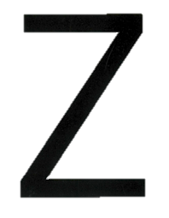

Zip across,
Zag down,
and across the zebra.
Menu
The letter name is…’zed’

